Slide 1
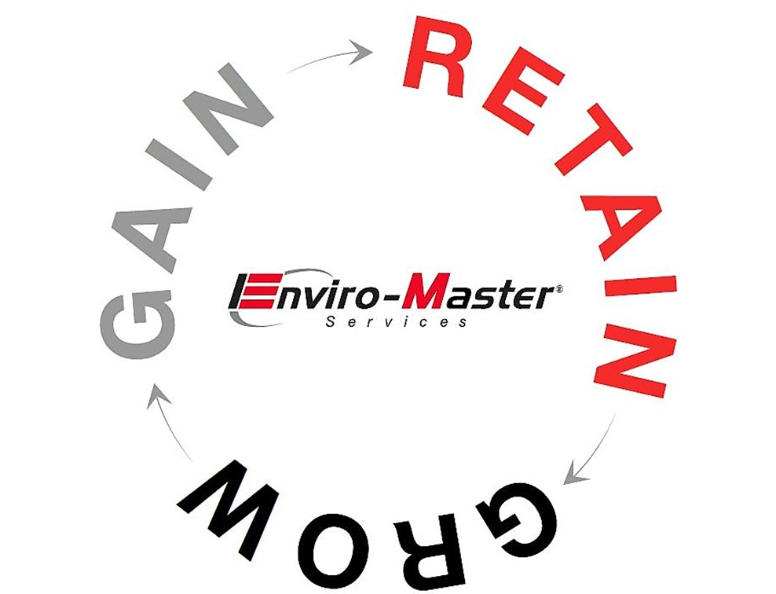
SBA Disaster Relief Loans

Slide 2
SBA Disaster Relief Loans
At this point all 50 states are qualified to receive funds. Applicants with an existing SBA Loan can qualify as well.
These loans may be used to pay fixed debts, payroll, accounts payable and other bills that can’t be paid because of the disaster’s impact. The interest rate is 3.75% and the term is 30-years.
Application and funds are delivered directly by the SBA, not by the banks. Some large banks are being utilized by the SBA now, but the process runs through the SBA, not the banks.
Your local Small Business Development Center offices can assist with questions about the application. Find your local office here: https://www.sba.gov/local-assistance/find/?type=Small%20Business%20Development%20Center&pageNumber=1

Slide 3
SBA Disaster Relief Loans
For More Information and to Apply:
SBA Disaster Relief - https://disasterloan.sba.gov/ela/Information/Index
Keep in mind they are being overwhelmed with applications, be patient with the site. It may take a few tries to get through.

Slide 4
Refinancing Current SBA Loans
Rates are at an 8-year low (6.0% currently)
Only 2 qualifications:
New P&I payment must be at least 10% less than current P&I payment.
You have to provide a written statement of how your business is affected by the COVID-19 outbreak.
Contact your current lender.
Banks can defer payments on the new loan for up to 6 months.

