Slide 1
SBA Disaster Loan Application Process

Slide 2
Enviro-Master
Steps to Apply for a Disaster Loan
Go to the Disaster Loan Assistance Website and Register.
https://disasterloan.sba.gov/ela/Information/Index
Register to get a login and password.
Apply for a Business Loan.
Be sure and select Economic Injury.
Provide the requested Information.
Business related info – Disaster Bus. Loan Application
Personal Financial Statement
Schedule of Liabilities
Economic Injury Disaster Loan Supporting Info
Tax Return Info
Submit the Loan Application

Slide 3
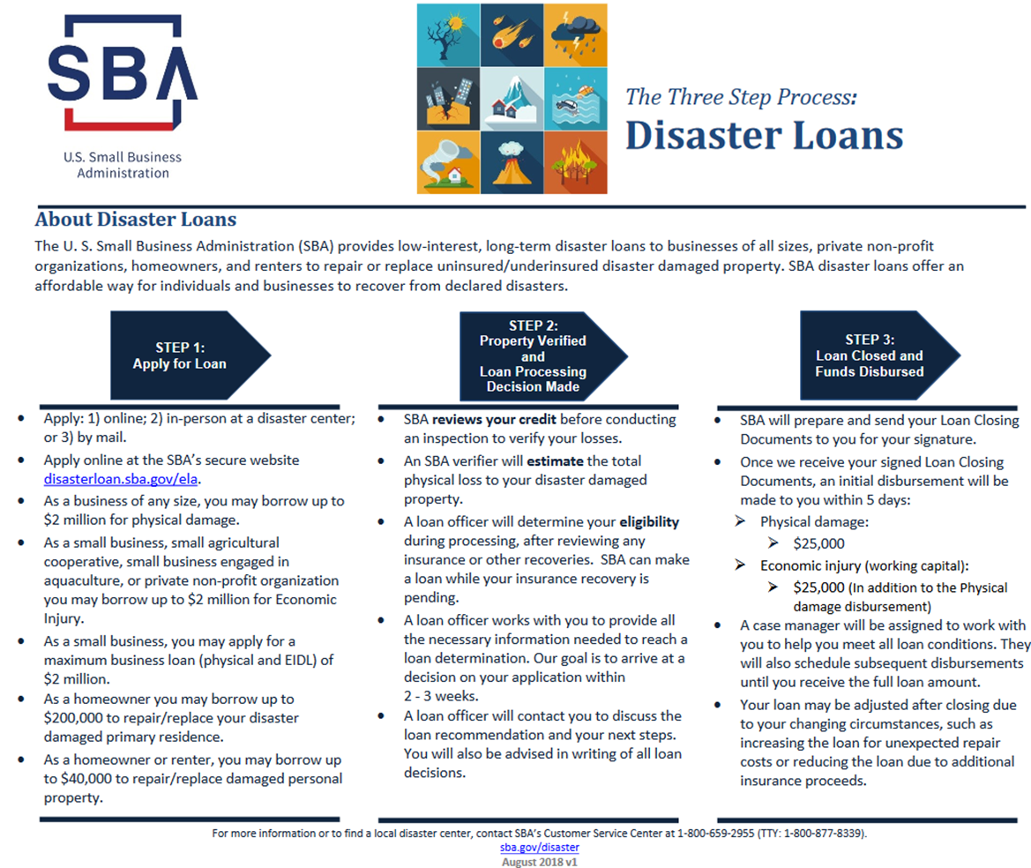
Overview of how the Disaster Loans process works.

Slide 4
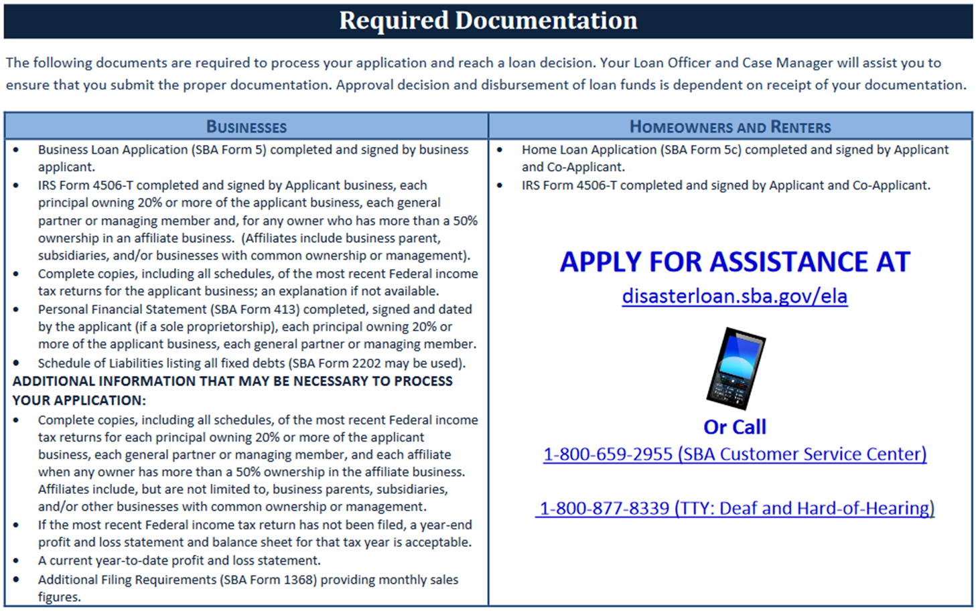
Helpful info on overall what is needed (cliff notes version).

Slide 5
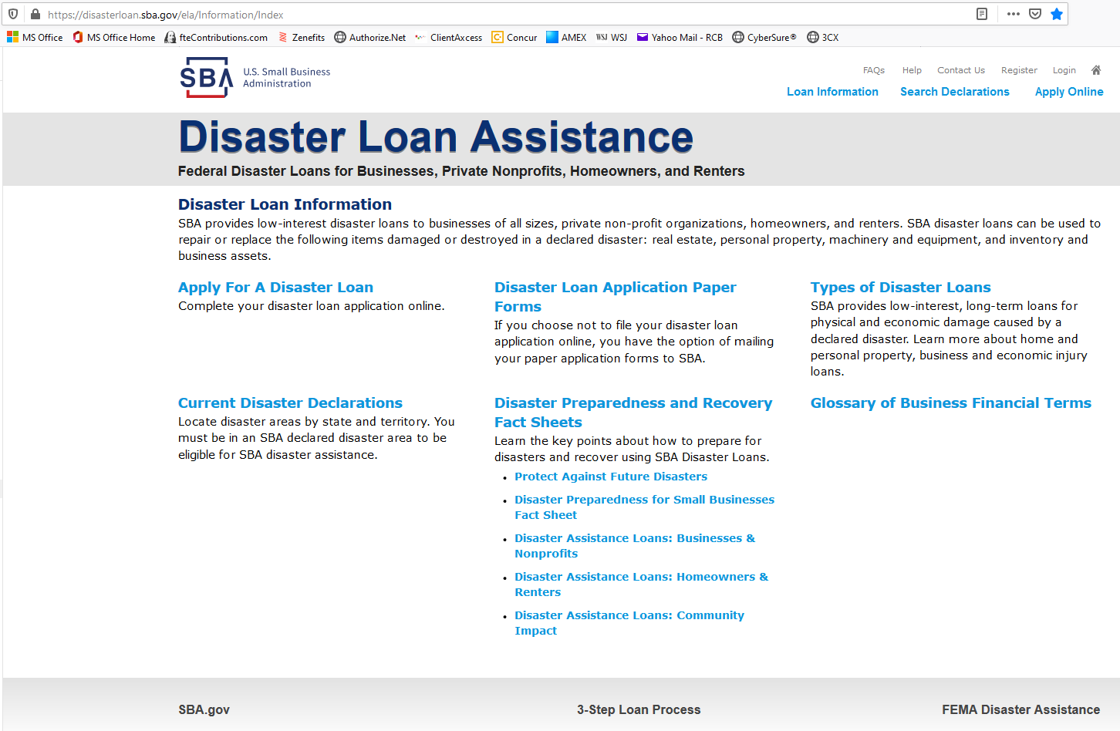
Click on Current Disaster Declarations to find out if your state/area is included in the disaster declaration.
Click Apply for a Disaster Loan to get started.

Slide 6
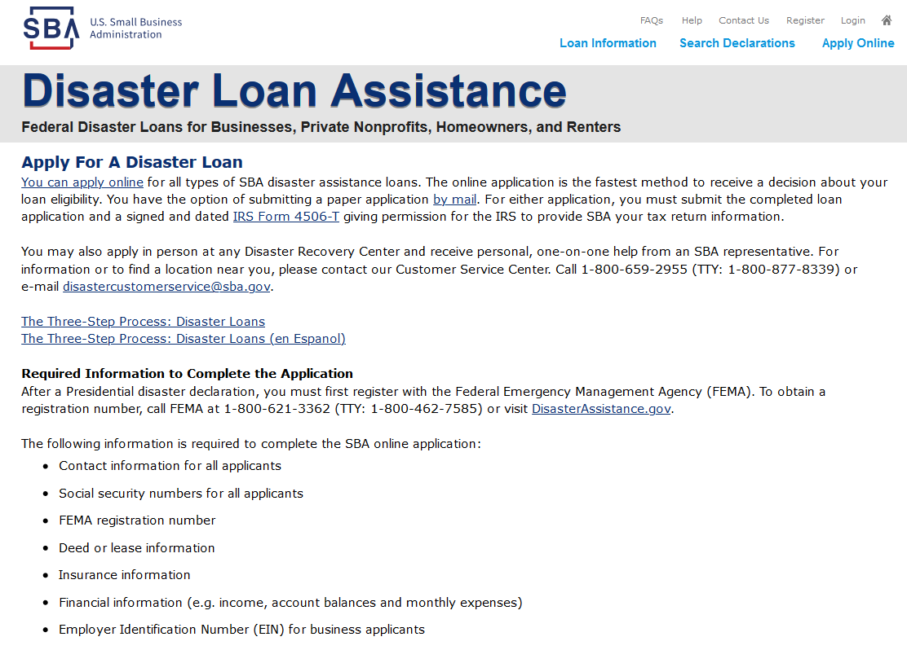
Click Apply Online to get started.

Slide 7
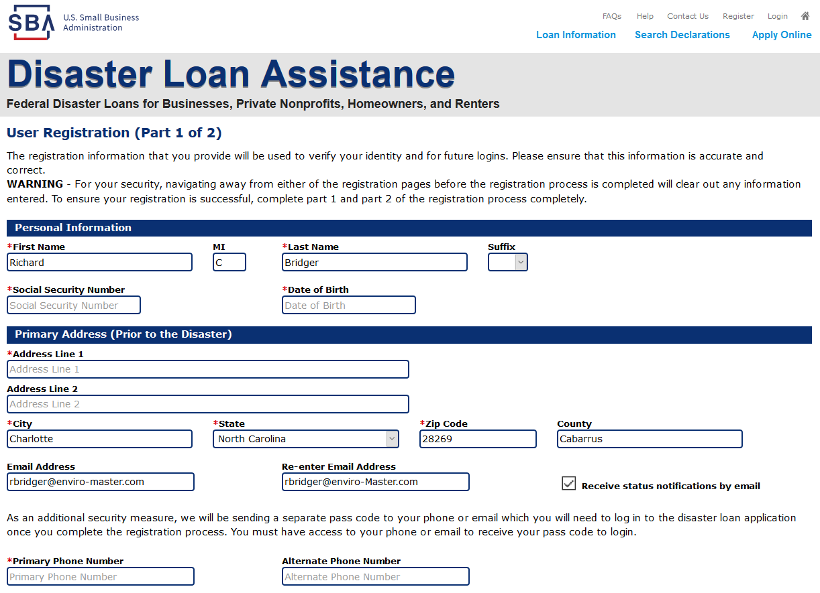
Complete the Registration Form.

Slide 8
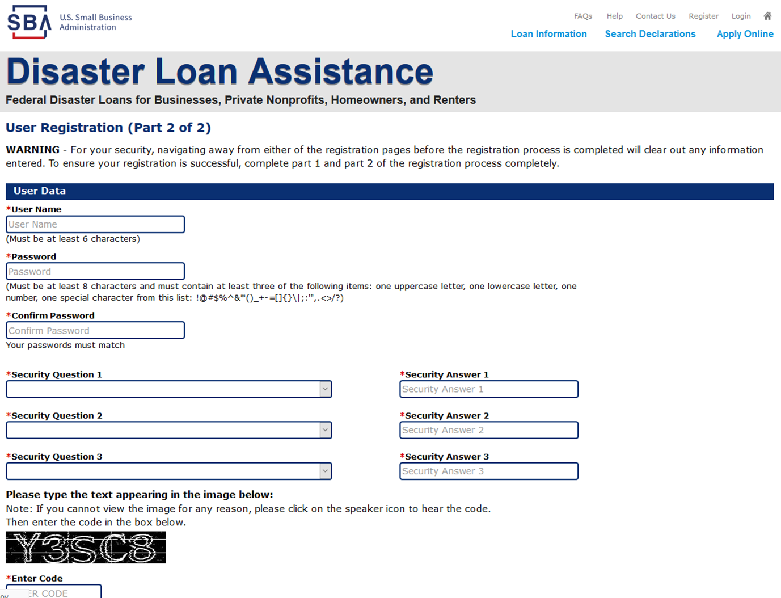
Complete the Registration Form with Security Questions.

Slide 9
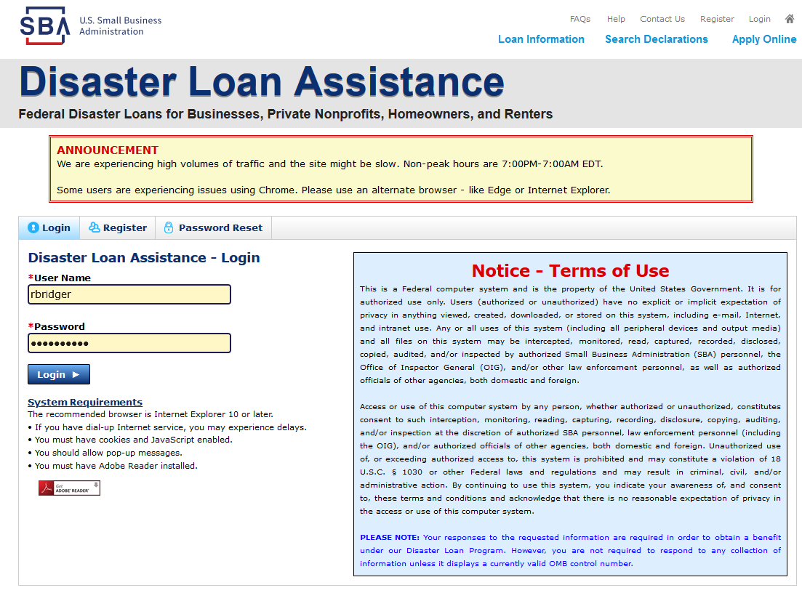
Login with password you just registered.

Slide 10
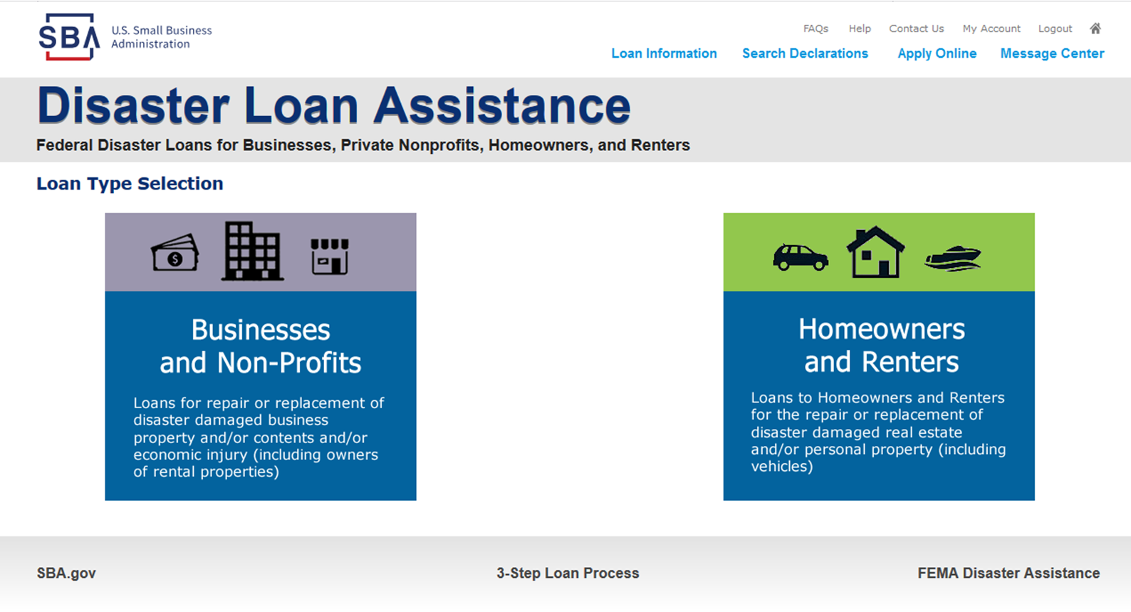
Click on Business type loan.

Slide 11
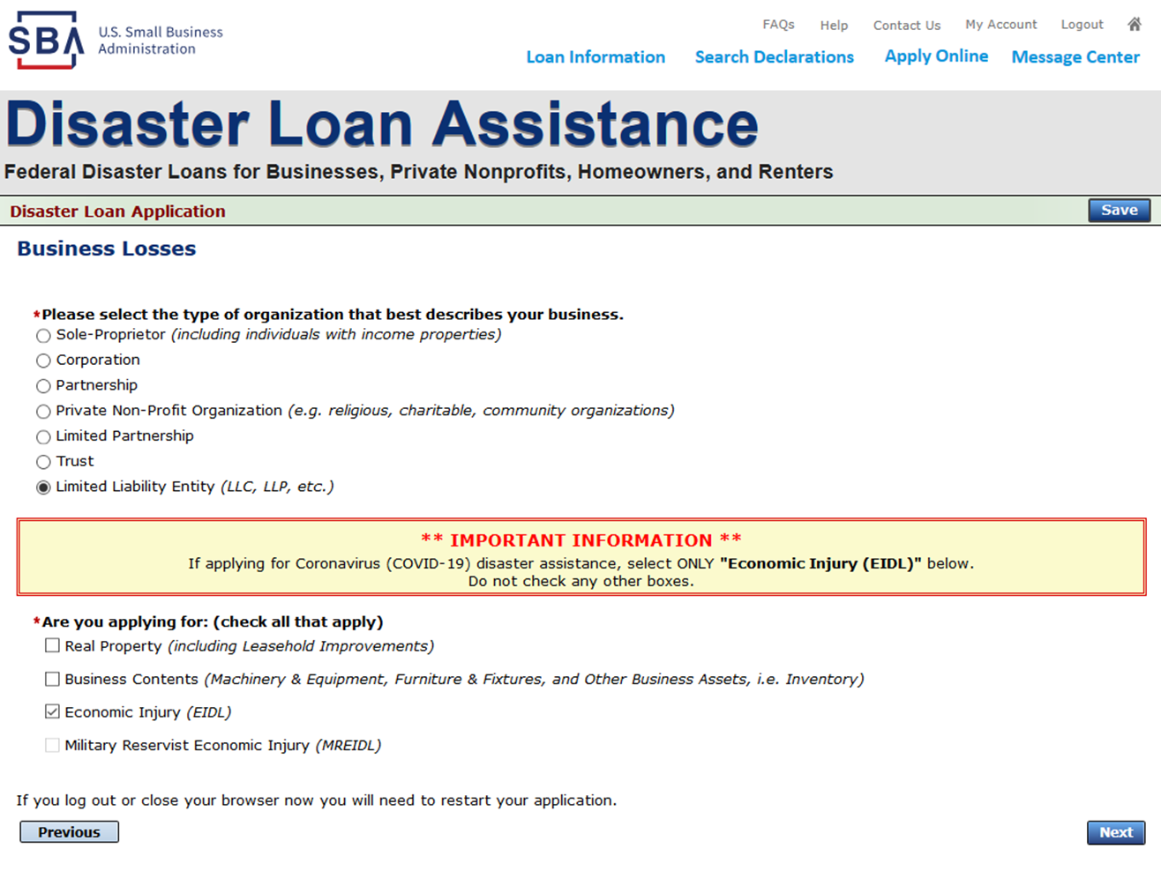
Check Organization type and select Economic Injury as the loan type (very important).

Slide 12
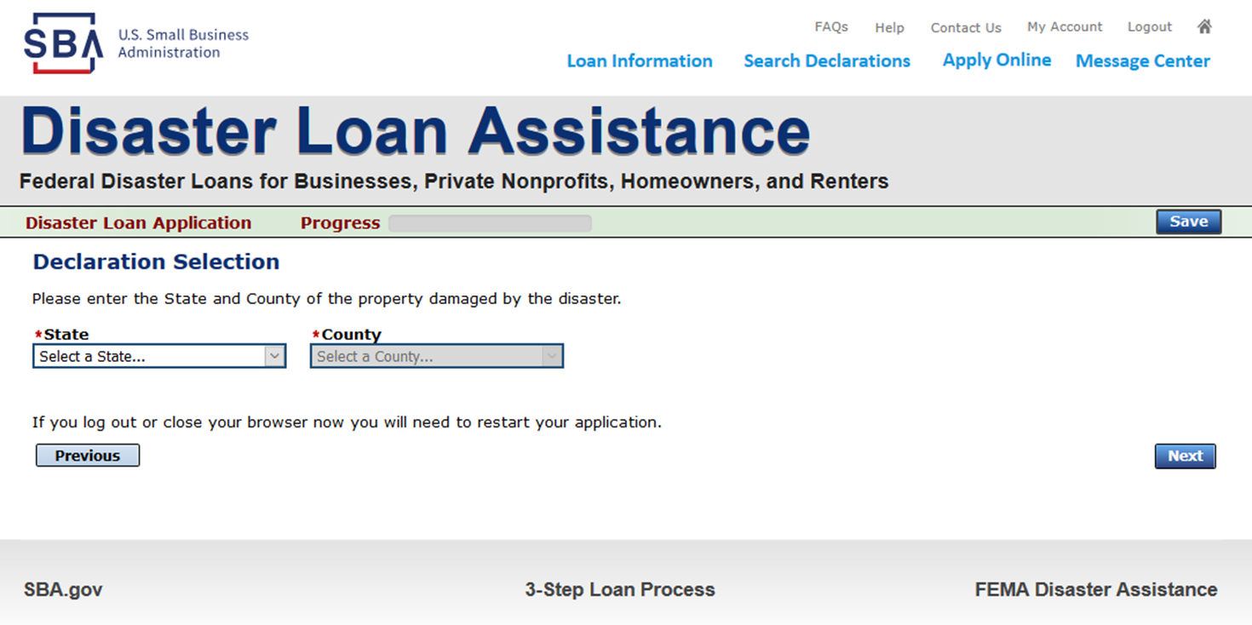
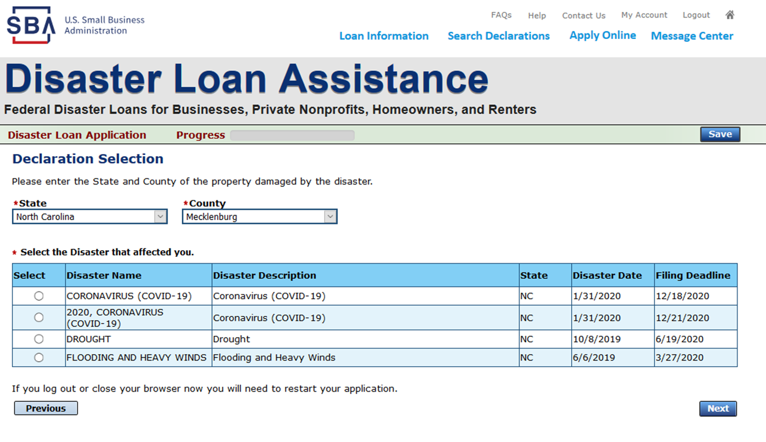
Select the appropriate state/area your business is located in.

Slide 13
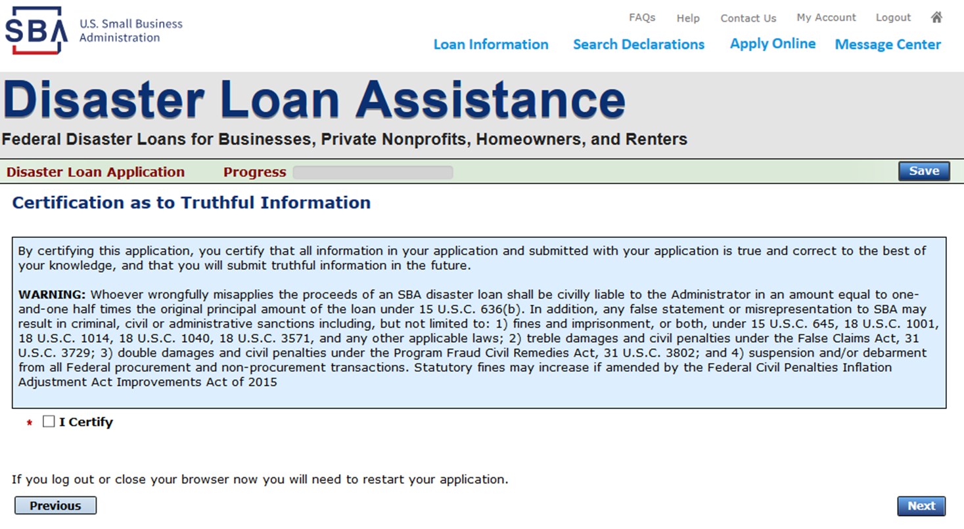
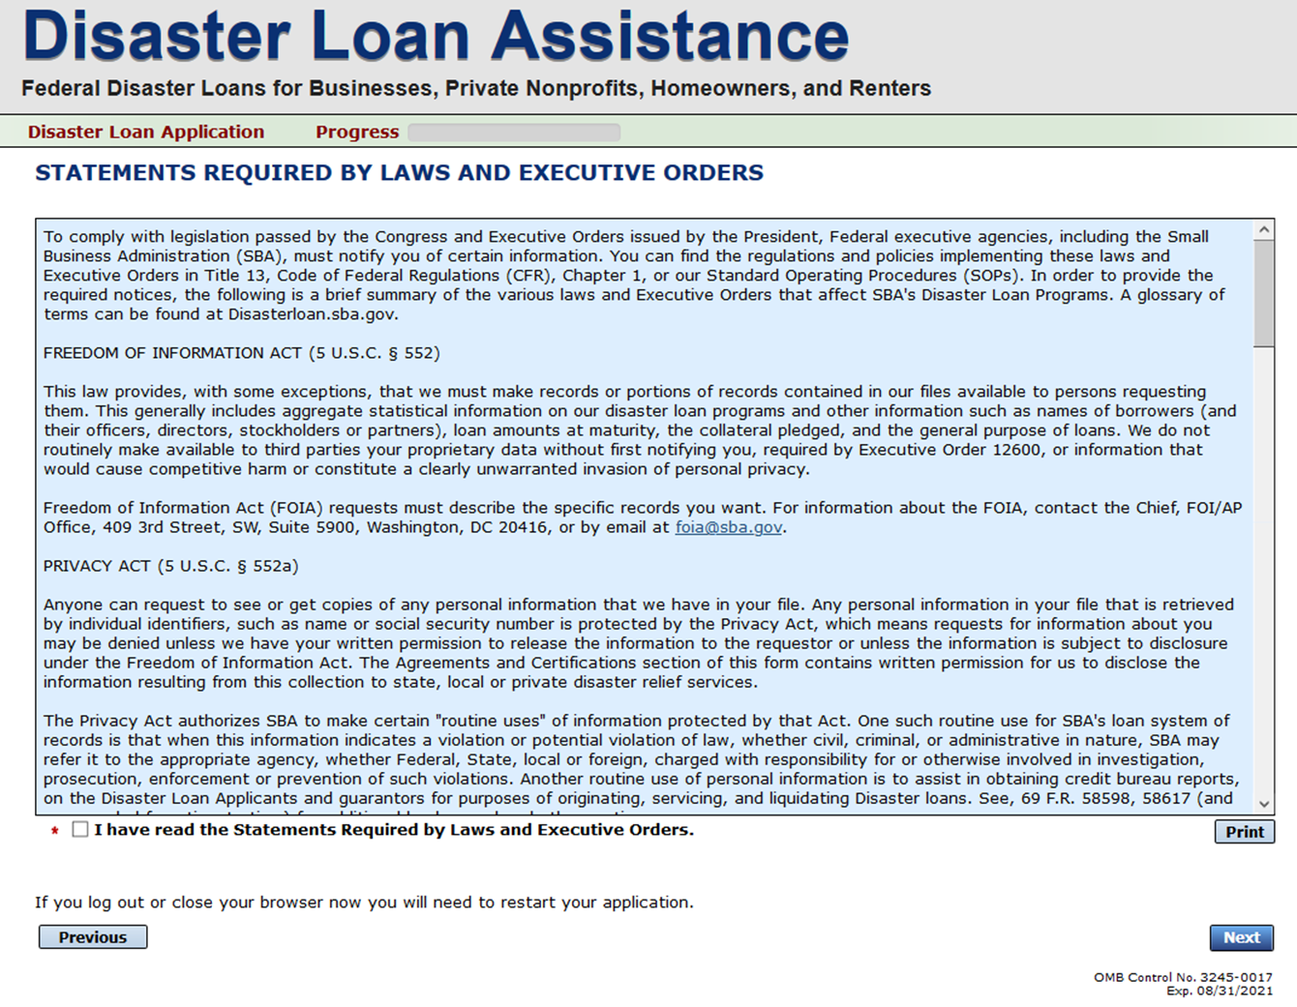
Click to certify you are providing truthful info.

Slide 14
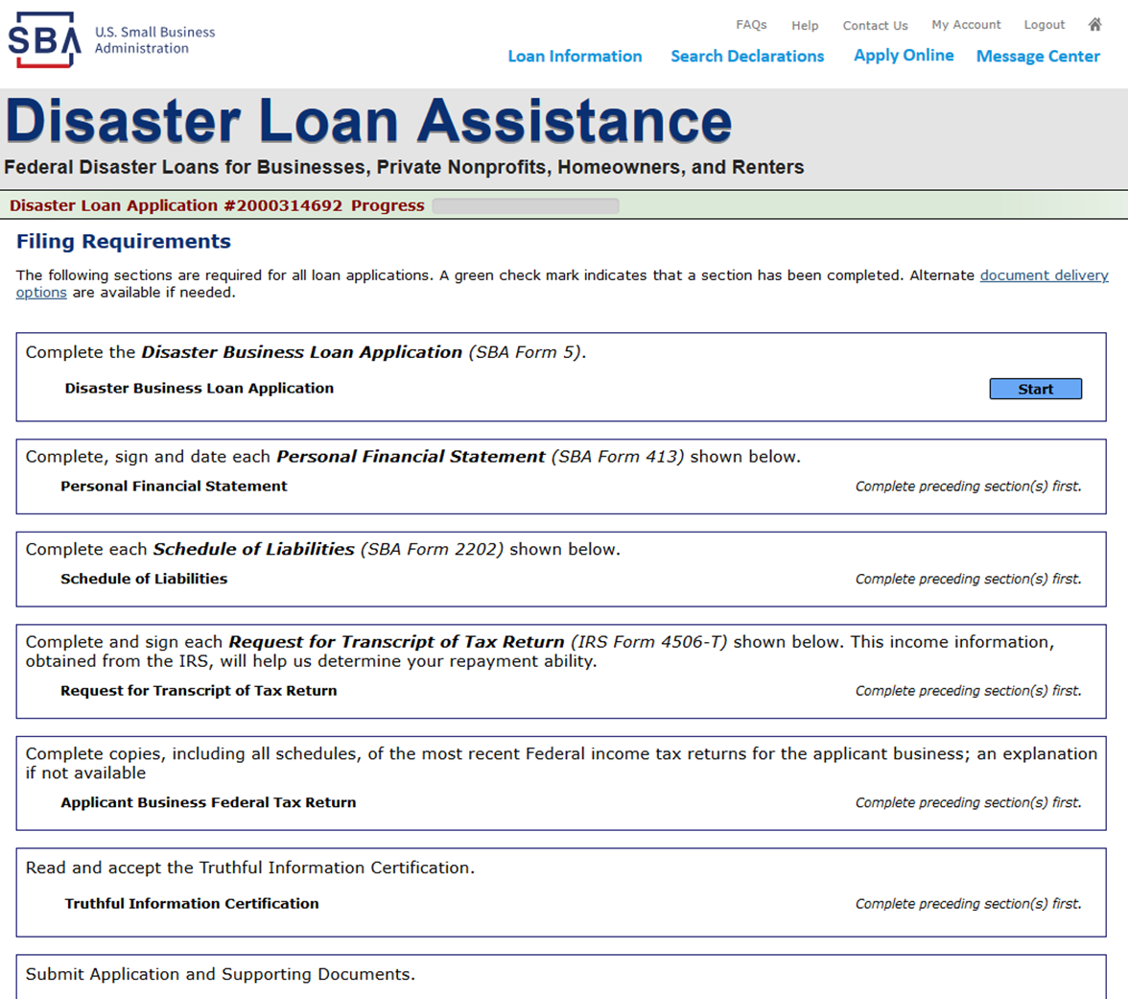
This is where you start with the application – All sections to be completed. You can save your spot at any point and log back in to complete your application.

Slide 15
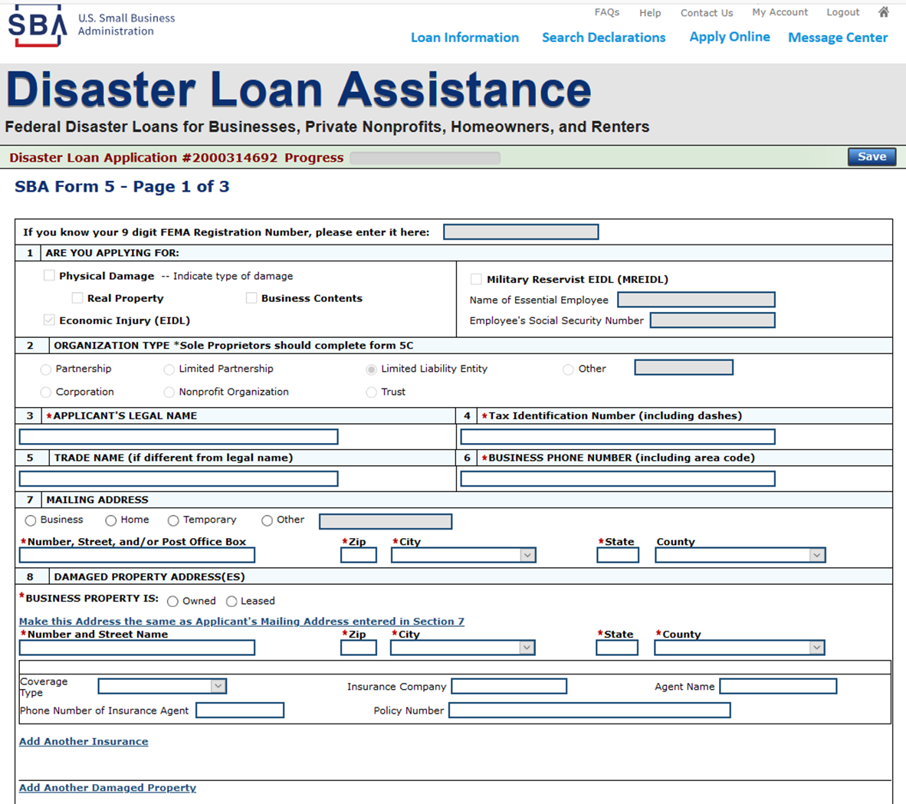
Fill out all the necessary info. If you don’t have a FEMA registration number, just keep going.

Slide 16
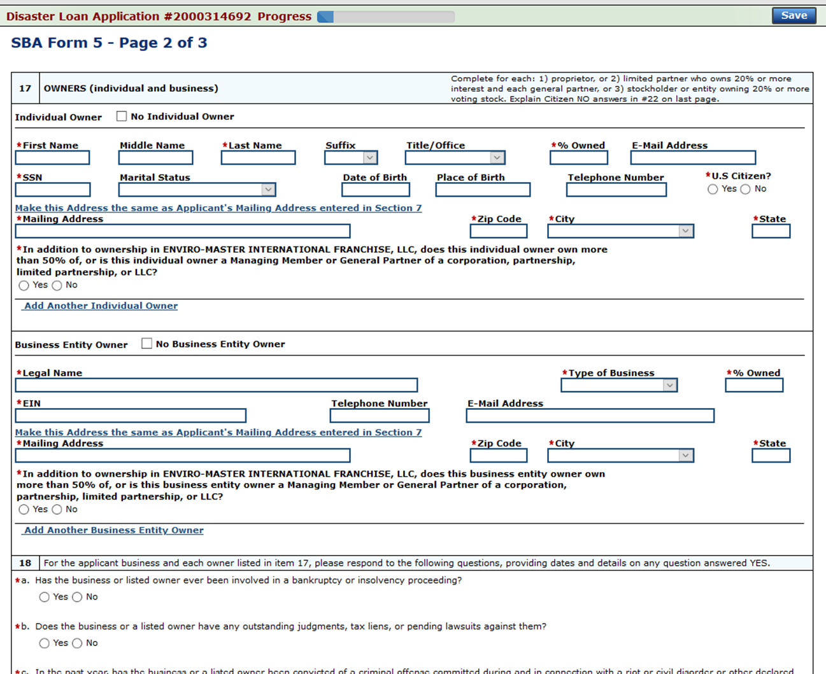
Fill out all the ownership info and other info.

Slide 17
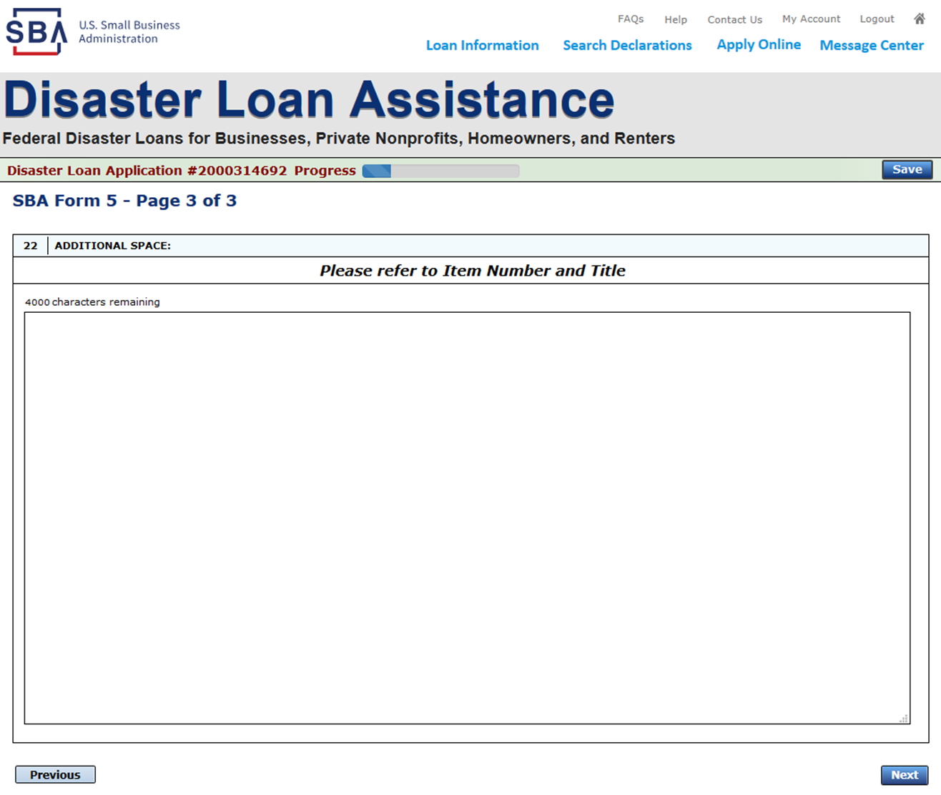
Extra section if needed to explain NO answers.

Slide 18
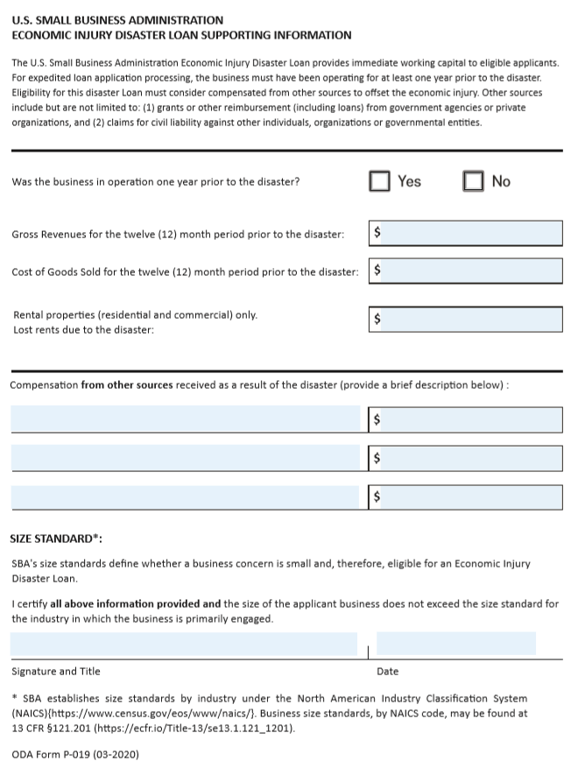
Fill this out completely and sign at the bottom.

Slide 19
Good Luck with the Application!

